Slide 1
Management-Readable Format working with the ImportExcel module
James O’Neill

Slide 2

Many thanks to our sponsors:

Slide 3

James O’Neill
PowerShell veteran since 2007
Avatar from www.sp-studio.de is almost as old
J@mobulaConsulting.com
Twitter: @JamesOneill
github: jhoneill
Blog https://jhoneill.github.io/

Slide 4
PowerShell + Excel + nothing else
Copy from Excel with headings
ConvertFrom-Csv (Get-Clipboard) -Delimiter "`t"
Export-CSV / Start FileName.csv
Paste to Excel & use Data / Text-to-Columns
Manipulate Excel using the COM model
Use ODBC drivers to treat sheets as data tables.
All need Excel (no good for servers)

Slide 5
EPPlus library
For working with XSLX files (ONLY) in .NET
Does not require Excel (great for servers)
Some things only come to life when opened in Excel
V4 free to use
Good coverage of Excel Features, but not 100%
Module grew out Doug Finke’s importer… This talk focuses on Export

Slide 6
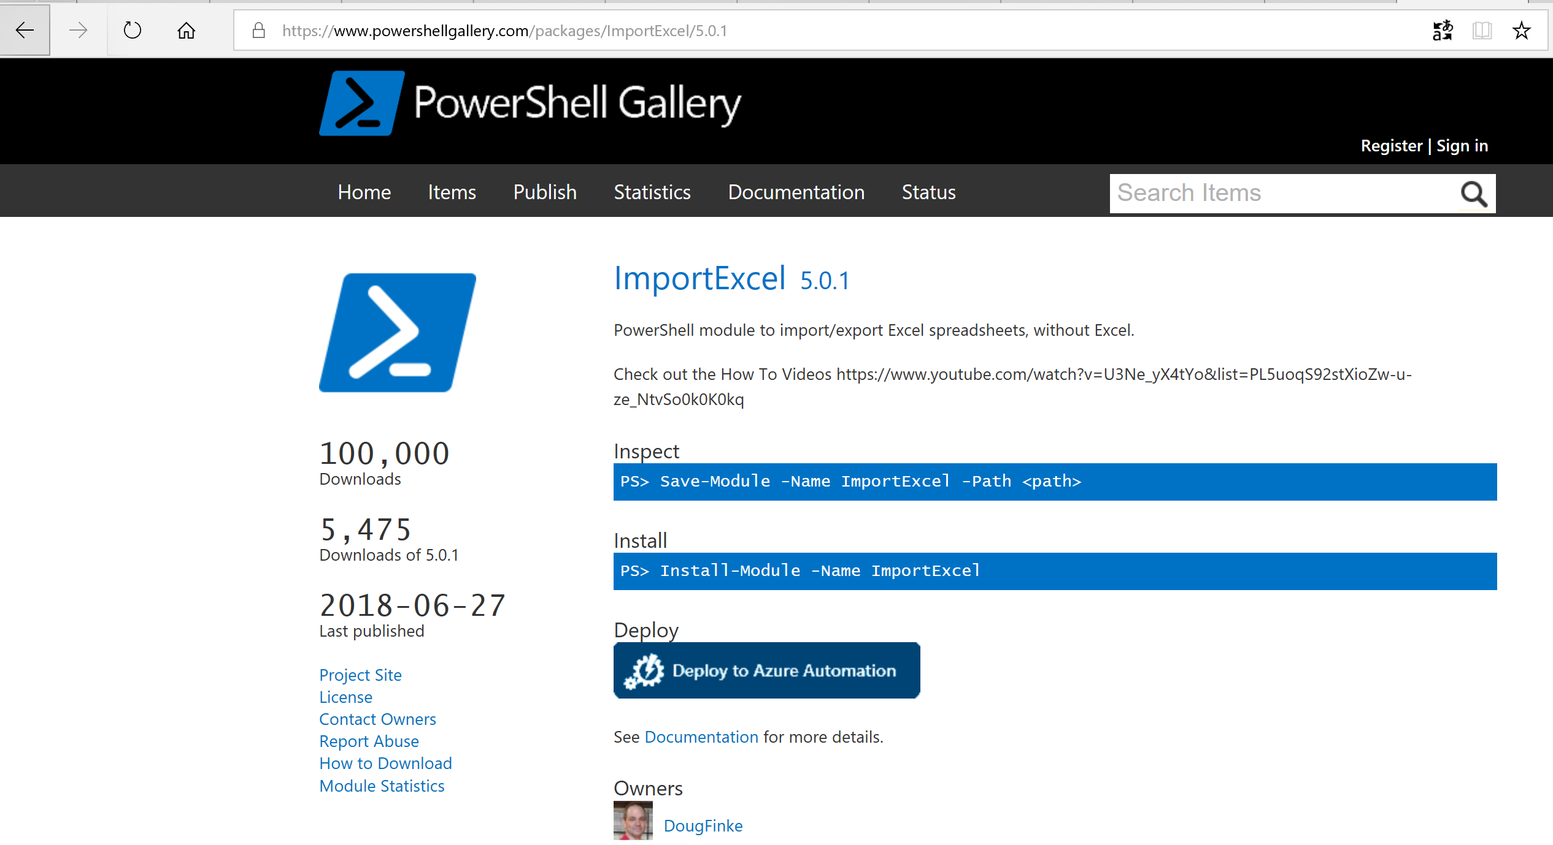

Slide 7
ImportExcel the module
Cross platform – incl. cloud shell & Azure DevOps pipelines
Use cases
PowerShell to extract and transform Excel data
Receive / track config in Excel, apply with PowerShell
Get information with PowerShell, extend / present using Excel
Excel Formulas to go beyond Select-Object, Measure-Object
Charts, Pivots, Conditional formatting, Differences
Most import / export needs to be Cell-by-Cell

Slide 8
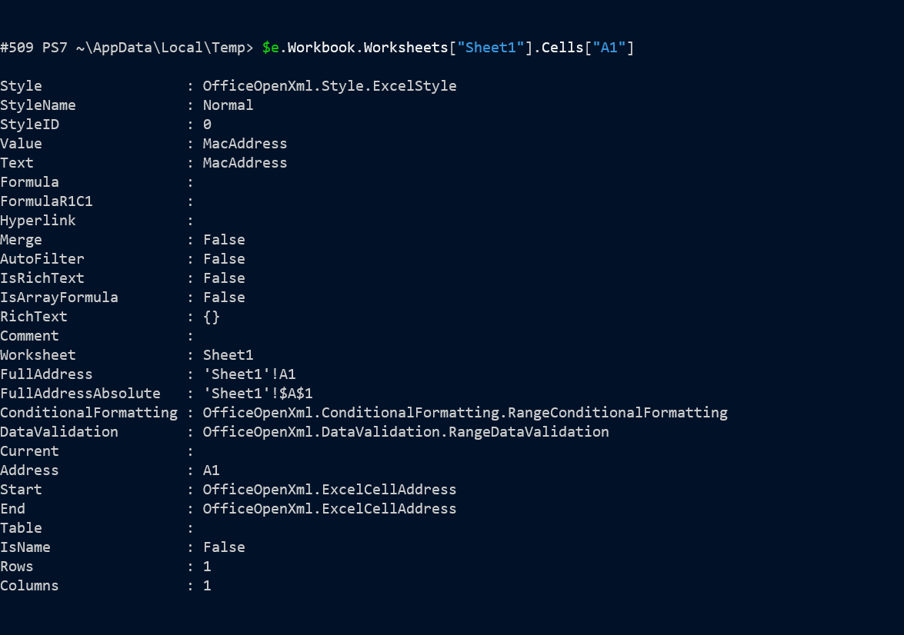
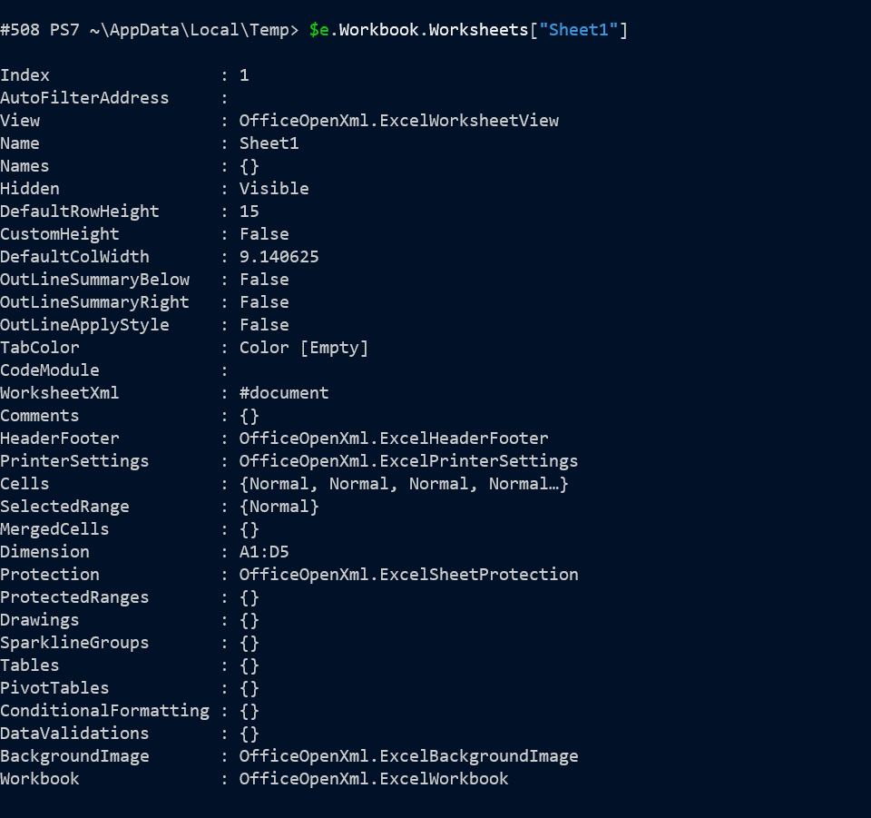
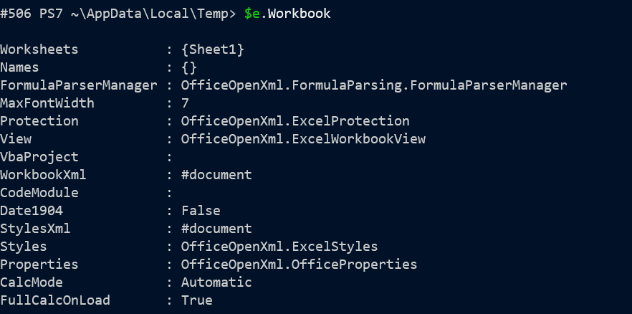
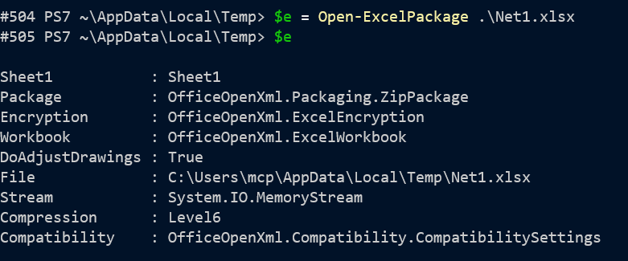
Object Model

Slide 9
Object Model (2)
If EPPlus supports a feature, you can see how by exploring an existing XLSX which uses it
Module reduces the need for low level hacks
Export-Excel function handles ~ 90% of output needs
With extra tools handles ~ 99 %
Last ~ 1% need the object model

Slide 10
Import
Basic
Read first sheet
Treat first row as header
Rows → Objects ; Column names → Properties
Options
Different sheet
Headers aren’t at row 1 , are missing or “wrong”
Don’t want all columns or rows
Force string conversions

Slide 11
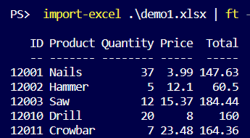
Main uses
Load parameters – fix names, Pipe or Splat
Data transformation

Slide 12
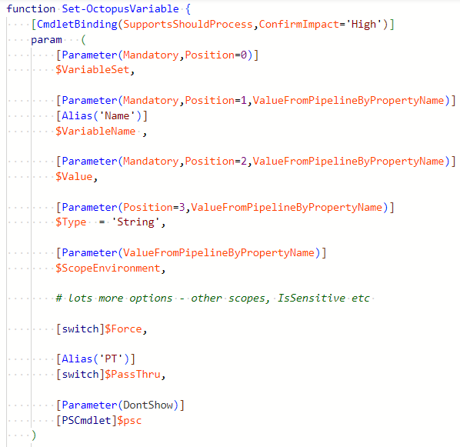
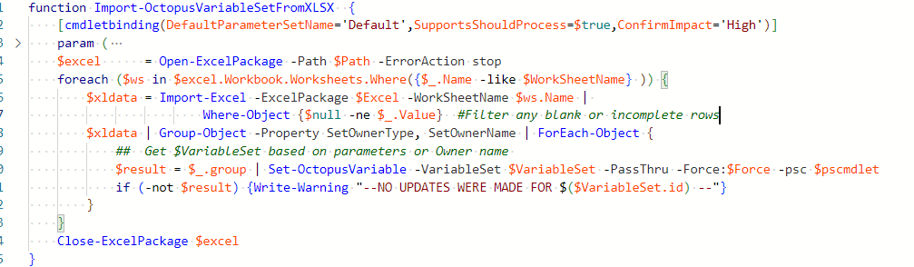
Parameter import

Slide 13
Export
Apologies to Tolstoy “All imports of data resemble each other, each export of data does an export in its own way”
Many, Many export options! Most basic
First object’s properties → column headings Update-FirstObjectProperties
Objects → rows
Lots of sources. Lots of “Looks”

Slide 14
When I said many options…
Export-Excel [[-Path]] [-InputObject] [-Calculate] [-Show] [-WorksheetName] [-Password] [-ClearSheet] [-Append] [-Title] [-TitleFillPattern] [-TitleBold] [-TitleSize] [-TitleBackgroundColor] [-IncludePivotTable] [-PivotTableName] [-PivotRows] [-PivotColumns] [-PivotData] [-PivotFilter] [-PivotDataToColumn] [-PivotTableDefinition] [-IncludePivotChart] [-ChartType] [-NoLegend] [-ShowCategory] [-ShowPercent] [-AutoSize] [-MaxAutoSizeRows] [-NoClobber] [-FreezeTopRow] [-FreezeFirstColumn] [-FreezeTopRowFirstColumn] [-FreezePane] [-AutoFilter] [-BoldTopRow] [-NoHeader] [-RangeName] [-TableName] [-TableStyle] [-Barchart] [-PieChart] [-LineChart] [-ColumnChart] [-ExcelChartDefinition] [-HideSheet] [-UnHideSheet] [-MoveToStart] [-MoveToEnd] [-MoveBefore] [-MoveAfter] [-KillExcel] [-AutoNameRange] [-StartRow] [-StartColumn] [-PassThru] [-Numberformat] [-ExcludeProperty] [-NoAliasOrScriptPropeties] [-DisplayPropertySet] [-NoNumberConversion] [-ConditionalFormat] [-ConditionalText] [-Style] [-CellStyleSB] [-Activate] [-Now] [-ReturnRange] [-PivotTotals] [-NoTotalsInPivot] [-ReZip] [<CommonParameters>]

Slide 15
PowerShell command output:
Above: Octopus Deploy – Project x Environment
Conditional format to highlight unsuccessful

Slide 16
Screen Scraping

Slide 17
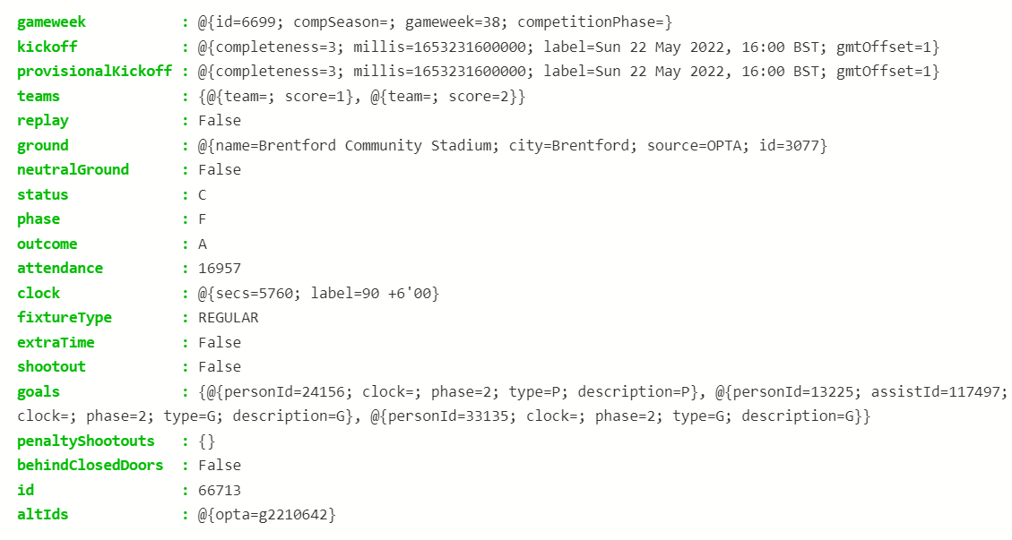
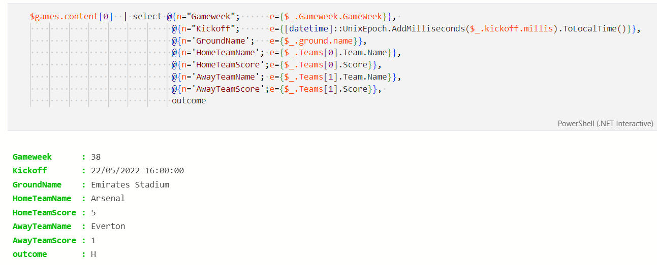
Transform (1)

Slide 18
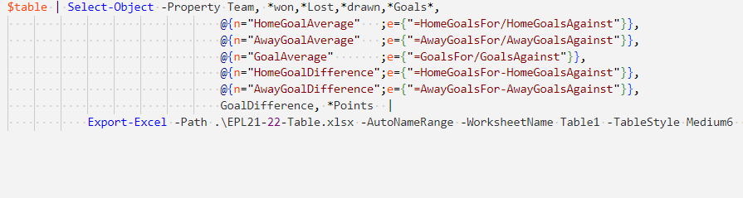
Transform (2)
More than Select and do calculations in PowerShell
Add Objects (rows) with Excel Formulas as Properties (Cells)
Use Select-Object / Add-Member to add properties / cells to each row
Try the PowerShellPivot module – another Finke/O’Neill product

Slide 19
Match & Compare / Merge

Slide 20
Present

Slide 21
Not in the demo
Pivot charts are easier than normal ones!
Quick Bar / Column / Line / Pie charts
$data | ColumnChart –NoLegend –Title "Downloads"
Or use -AutoNameRange & New-ExcelChartDefinition
$locations = $data.location | Sort-Object -Unique
$cdef = New-ExcelChartDefinition -ChartType ColumnClustered -Title "Sales" ` -XRange Product -YRange $locations -SeriesHeader $locations
$data | Export-Excel $env:temp\chart.xlsx -ExcelChartDefinition $cdef -AutoNameRange ...

Slide 22
Demos
We love Demos!

Slide 23
Q&A

